Slide 1

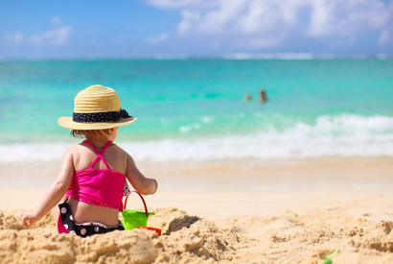
Unit 7 Summer

Slide 2
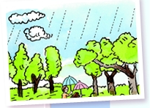
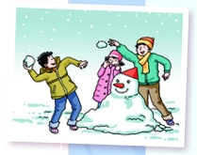
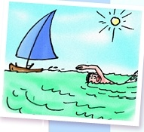
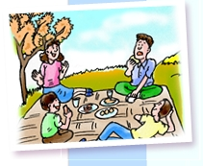
The four seasons
Winter
Spring
Summer
Autumn

Slide 3
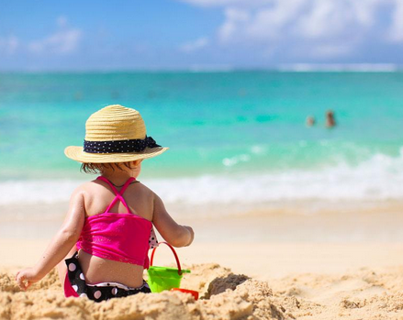
In summer
In Summer, I play on the beach.

Slide 4
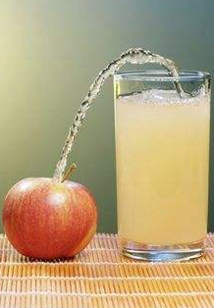
In summer
In Summer, I drink orange juice.

Slide 5
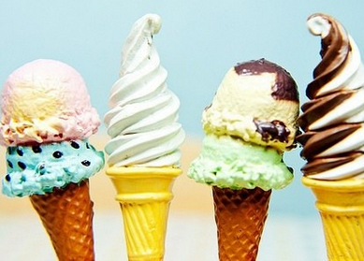
In summer
In Summer, I eat ice cream.

Slide 6
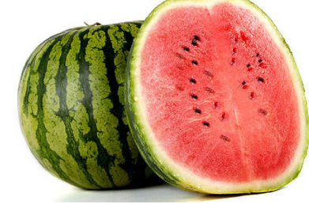
In summer
In Summer, I eat watermelons.

Slide 7
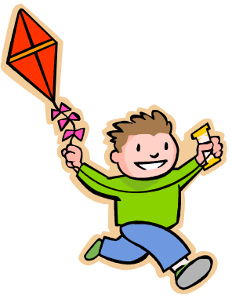
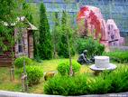
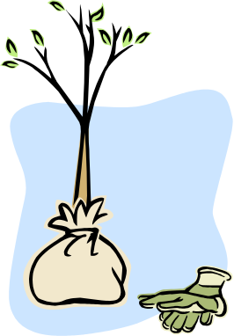
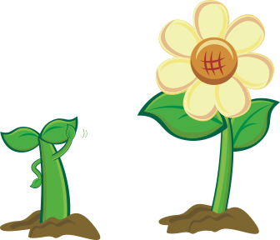

What do you do in spring?
fly a kite
go to the park
plant flowers
plant trees

Slide 8
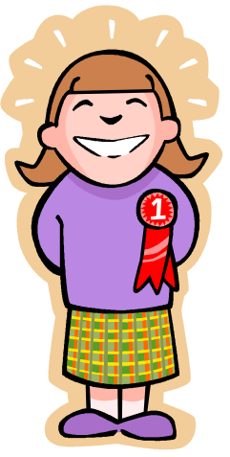

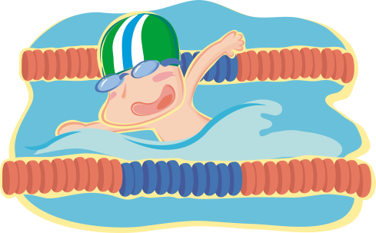
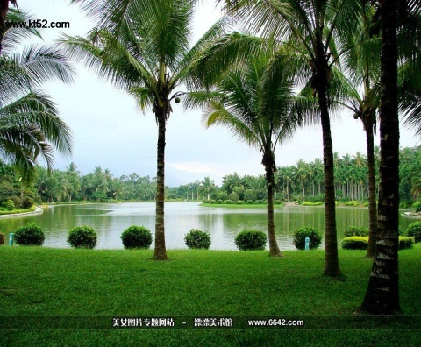
What do you do in summer?
eat ice cream / watermelon
go swimming
go to Hainan on holiday

Slide 9
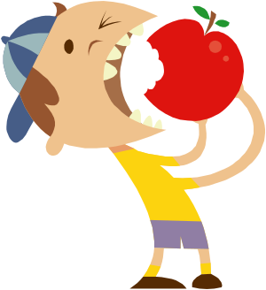
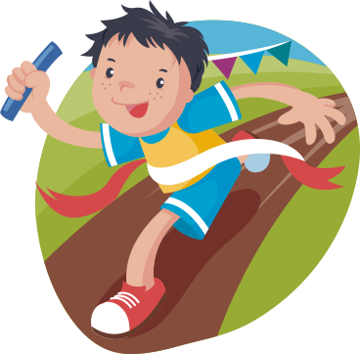
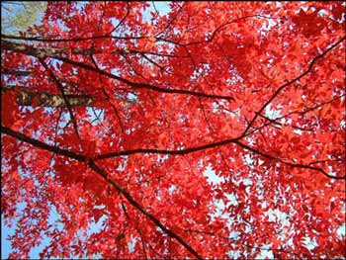
What do you do in autumn ?
eat apples/ fruits
have sports meeting
see red leaves

Slide 10

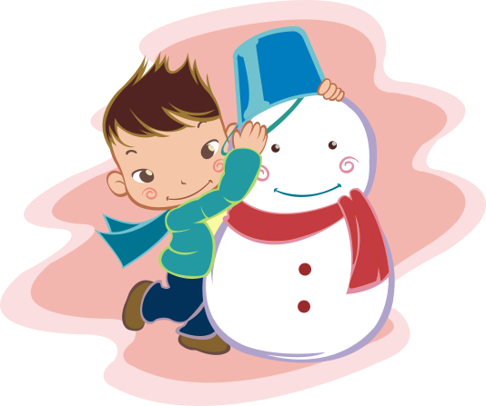
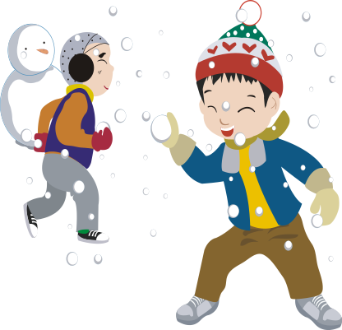
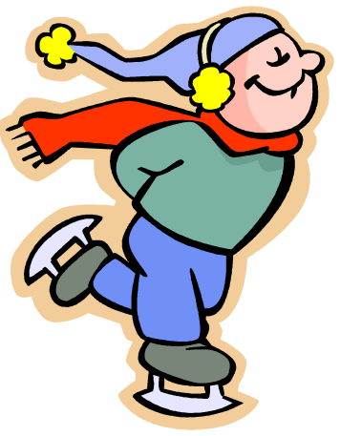
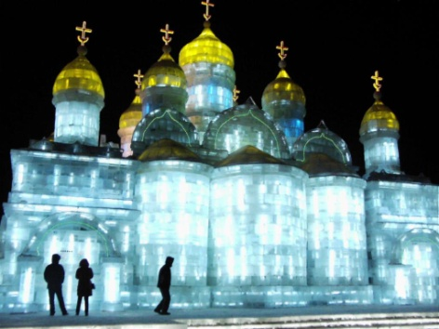
What do you do in winter?
make a snowman
play with snow
go skating
go to Harbin

Slide 11
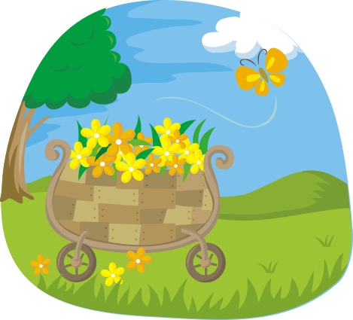
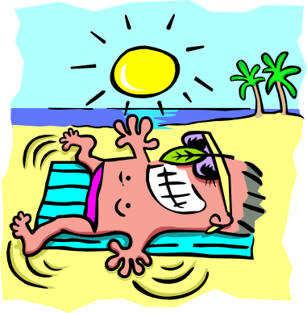
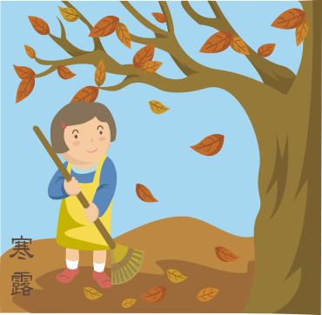
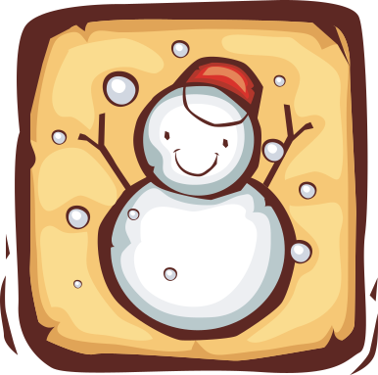
My favorite season
spring
summer
autumn
winter
warm
hot
cool
cold

Slide 12

Which season do you like?
My favourite season
________ is the best season…
/ I like _____ best…

Slide 13
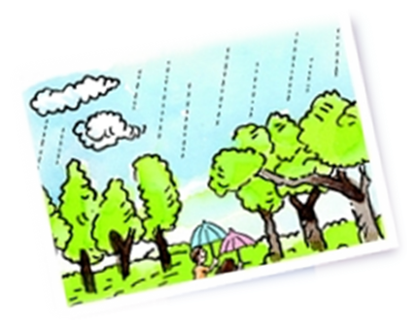
Read and Practice
Spring
In spring, the weather starts to get warm. The wind blows gently. It often rains. Plants start to grow. Everything turns green.
It is exciting to take a trip in spring.

Slide 14
Enjoy our life in every season!

